Slide 1

ICS2607 Information Management
Data Design: Entity-Relationship Model
Topic No. 3
Information Technology
College of Information and Computing Sciences
University of Santo Tomas

Slide 2
Intended Learning Outcomes
At the end of this topic, the learners will be able to:
  create and interpret Entity-Relationship (ER) diagrams accurately, representing entities, attributes, relationships, and cardinality;
  design a relational database schema by identifying entities, attributes, and relationships, and then apply normalization techniques to eliminate data redundancy, ensuring data integrity;

Slide 3
Intended Learning Outcomes
At the end of this topic, the learners will be able to:
  define and apply cardinality and participation constraints correctly within an ER diagram, understanding how they govern relationships between entities; and
  evaluate a given database design, identifying potential improvements for efficiency, data integrity, and usability, and apply optimizations as needed.

Slide 4
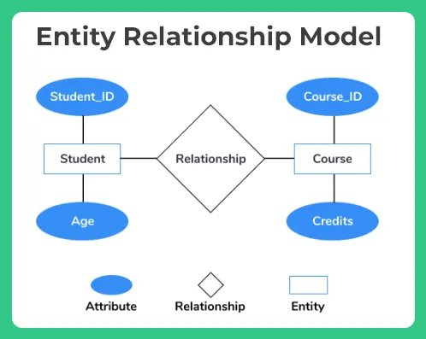
I: The Entity-Relationship Model
The Entity-Relationship Model is a conceptual framework used in database design to describe the structure of a database. It focuses on representing entities (objects, concepts, things) and the relationships between them.
Notes:
Or

Slide 5
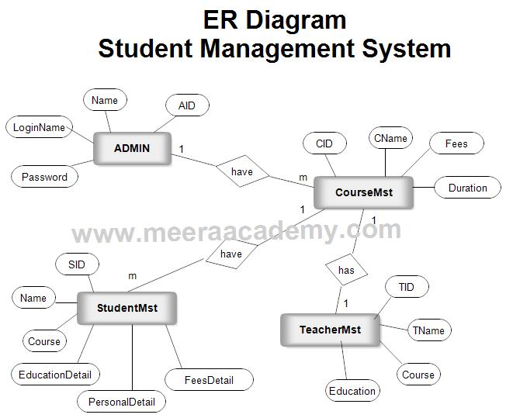
The Entity-Relationship Model
An Entity-Relationship Diagram (ERD) is a visual representation of the Entity-Relationship Model. It is a diagrammatic way to illustrate the entities, attributes, and relationships within a database system.

Slide 6
Entity Relationship Model
The ER Model approach to data modeling is proposed by P. Chen in 1976. The model says that you divide your database into two logical parts, entities (e.g. "customer", "product") and relations ("buys", "pays for").

Slide 7
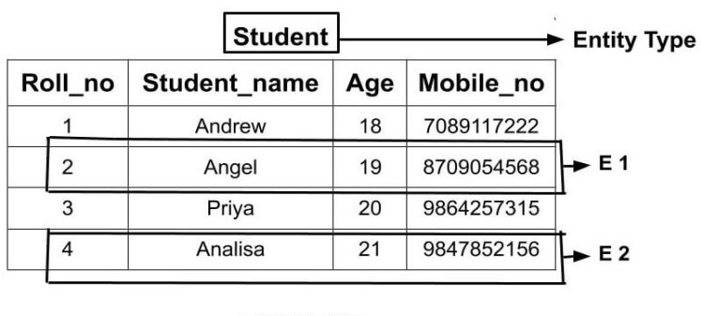
Entity Relationship Modelling
Entity ( - entity symbol )
- A collection of things that share common properties or characteristics
- In a database, anything about which information can be stored; for example, a person, concept, physical object or event. Typically refers to a record structure.
May describe:
Roles-people or organizations: EMPLOYEE
Tangible things: MACHINE, BUILDING
Events: SALE, REGISTRATION
Locations: STATE, BRANCH
Concepts: COURSE

Slide 8
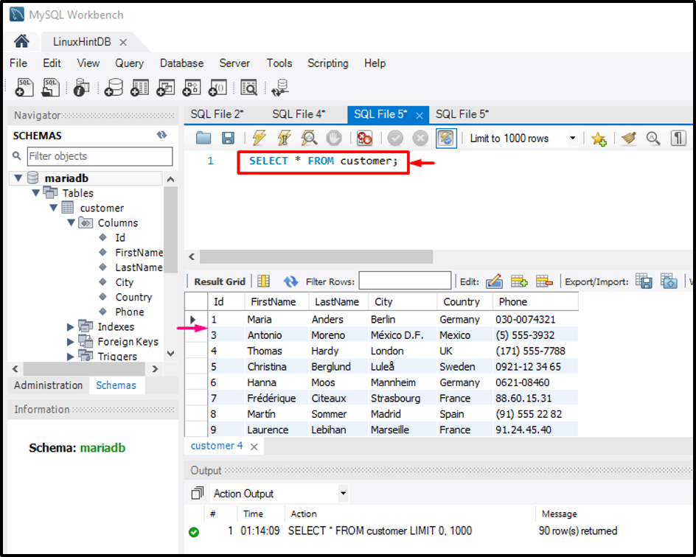

Slide 9
Entity Relationship Model

Slide 10
Entity Relationship Modelling
Types of Attributes
1.Composite – can be divided into simple attributes (e.g., Address, Street, Barangay, City)
2. Simple or Atomic – indivisible (e.g., Age)
3.Single-Valued – a single value attribute (e.g., Age = 27)
4.Multi-Valued – an attribute can have multiple values (e.g., College Degree = BSCS, BSBA, BEED)
5.Derived – value of an attribute that is derived from another attribute (e.g., Age is derived from Birthday and Current Date, Birthday and Current Date are related attributes)

Slide 11
Entity Relationship Modelling

Slide 12
Relationship

Slide 13
Types of Relationship

Slide 14
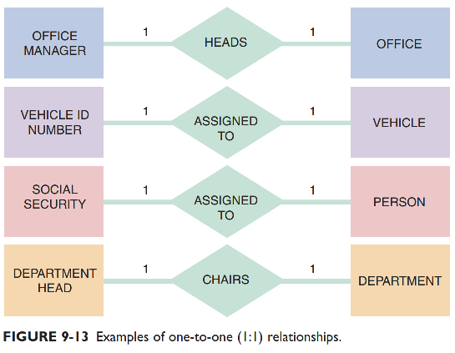
Relationships
1 : 1 Relationship

Slide 15
Types of Relationship

Slide 16
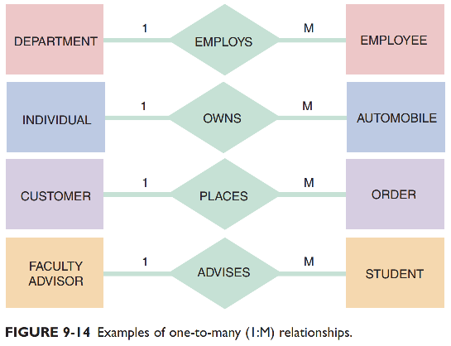
Relationships
1 : M Relationship

Slide 17
Types of Relationship

Slide 18
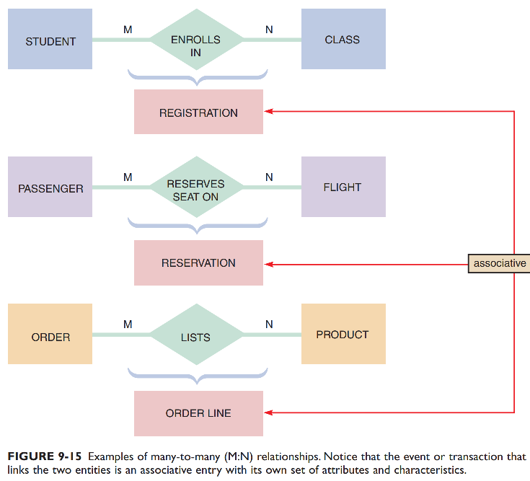
Relationships
M : M Relationship

Slide 19
Degree of Relationship

Slide 20
Degree of Relationship

Slide 21
Degree of Relationship

Slide 22
Cardinality Constrains
  Minimum cardinality – the minimum number of instances of one entity that may be associated with each instance of another entity
  Maximum cardinality – the maximum number of instances of one entity that may be associated with a single occurrence of another entity
Notes:
a limitation or restriction that you can set for the relationship of each entity
Basketball team

Slide 24
Relationship Cardinality

Slide 25
Relationship Cardinality

Slide 26
Relationship Cardinality

Slide 27
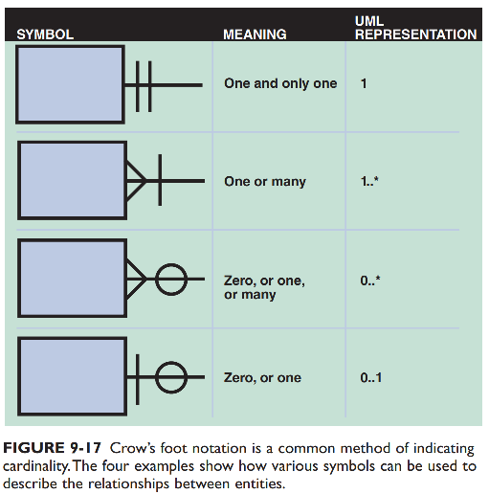
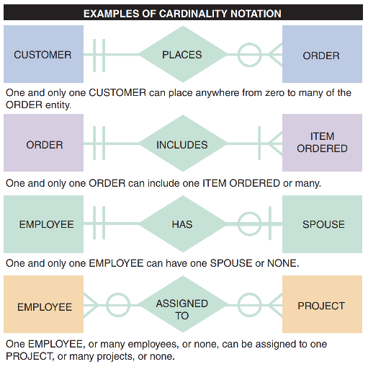
Connectivity and Cardinality

Slide 28
Exercises
Given the following business rules, create the appropriate Crow’s Foot ERD.
a. A company operates many departments.
b. Each department employs should one or more employees.
c. Each of the employees may or may not have one or more dependents.
d. Each employee may or may not have an employment history.

Slide 29
Exercises
Given the following business rules, create the appropriate Crow’s Foot ERD.
a. A company operates many departments.
b. Each department employs should one or more employees.
c. Each of the employees may or may not have one or more dependents.
d. Each employee may or may not have an employment history.

Slide 30
Example: Car Dealership
Create an ERD for a car dealership. The dealership sells both new and used cars, and it operates a service facility. Base your design on the following business rules:
A salesperson may sell many cars, but each car is sold by only one salesperson.
A customer may buy many cars, but each car is bought by only one customer.
A salesperson writes a single invoice for each car he or she sells.
A customer gets an invoice for each car he or she buys.

